Slide 1






Looking for an exciting career?
Get into
Energy!

Slide 2


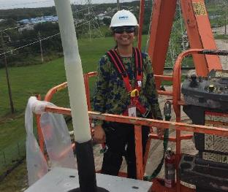
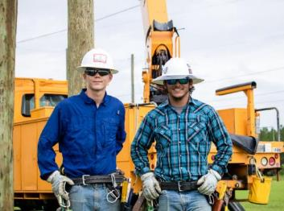

Every nationality
Every race
Every gender
Every background
Every lifestyle
Every level of education
There’s a place for YOU in the ENERGY industry!

Slide 3

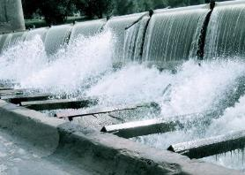



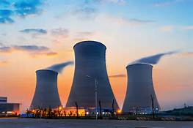
ENERGY powers our lives…
But have you considered a
career in
energy?

Slide 4






If you are interested in…
Opportunities for advancement
Great
benefits
Independence & making money
Community
service
Full training & apprenticeships
Job growth & stability
These benefits can be found in
energy careers!

Slide 5
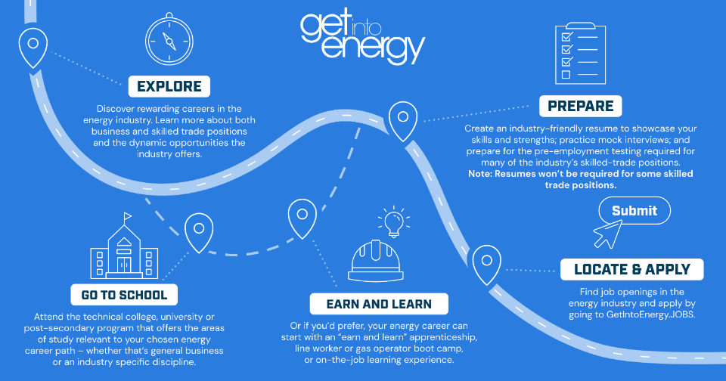

The Path of a Career in Energy

Slide 6


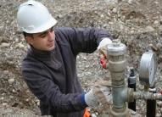



One industry….so many careers!
Lineworkers:
Heroes in hard hats who answer the call when the power goes out.
Engineers:
Designing the technology of the future.
Cyber Security:
Secret service agents for the company’s information technology.
Natural Gas Utility Technicians:
First responders of the energy industry.
IT/Networking:
Paving the lanes for the company’s information superhighway.
Welders:
Making the pieces fit together.

Slide 7

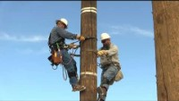
Lineworker
Watch this video to learn what it takes to be a lineworker
Heidi Killebrew
Restoration Specialist for Florida Power & Light
“I enjoy working in the energy field because I love a challenge. Your coworkers become like family, and if you take pride in your work and do a good job, this can be a very rewarding career. I can’t imagine doing anything else.”

Slide 8
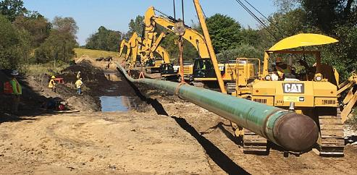


Gas Utility Technician
Gas utility workers are the backbone of the gas utility industry. They work above and below ground to:
Deliver clean, safe, reliable, and affordable natural gas to our homes and businesses
Installing and maintaining gas meters and regulators
Respond to routine requests for gas service and emergency damage repairs

Slide 9

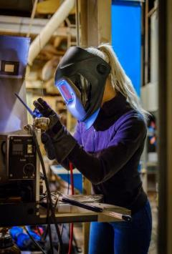
Welder
Do you have what it takes to be a great welder?…
Attentive to detail
Have good spatial orientation
Have manual dexterity
Enjoy working with your hands
Have excellent vision
Love to solve problems

Slide 10


Engineering
What type of
engineer could
YOU be?
Chemical
Civil
Computer
Electrical
Environmental
Industrial
Mechanical
Mechatronic
Nuclear
Petroleum
Software
…and more!

Slide 11
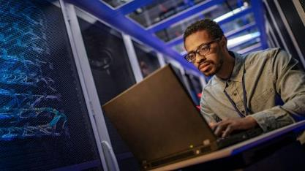

Cyber Security
Traits for success in a cyber security career*
An eye for detail: You will be looking closely for threats, loopholes & vulnerabilities
Good listener: You will be invaluable to your employer or clients if you engage this trait
A hunger to learn:
Technology is constantly changing!
Ethical standards: You will be the gatekeepers for sensitive and valuable information
Passionate for this field & industry: Having a passion will keep you motivated to keep learning
Know it’s not always obvious:
Be willing to think outside the box
*Adapted from: https://www.rasmussen.edu/degrees/technology/blog/qualities-of-cyber-security-professionals/

Slide 12
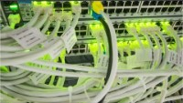

IT/Networking
Key skills required
Analyze, test, design & evaluate network systems (Internet & intranet)
Research & recommend network communications hardware and software
Provide server maintenance, problem diagnosis & assistance, account set up, equipment upgrades, training & troubleshooting
Preferred knowledge
Gain an associate’s or bachelor’s degree in computer science, information science, or management information systems
Stay current on new software, compatibility issues, etc.
Earn additional certifications in various software programs (i.e. Microsoft and Adobe)

Slide 13
Careers in Energy A to Z
Agri-Business/Science
Business Administration
Chemical Engineering
Data Analyst
Electrical Engineering
Finance
Geographical Information
Systems (GIS)
Human Resources
Information Technology
Jig Boring Machine Operator
Key Account Manager
Line Technician
Marketing
Nuclear Reactor Technician
Operations Manager
Plant Operator
Quality Engineer
Renewable Energy Specialist
Safety Management
Transmission Operator
Utility Technician
Vehicle Maintenance
Water Conservation Coordinator
eXplore for yourself and find other careers!
YOU can begin a rewarding career in energy!
“Zee” for yourself all the opportunities!

Slide 14








Ready to Get Started?
These schools offer energy programs!
Go to www.getintoenergy.com/locator
to find a school near you!

Slide 15










Find an awesome career in energy
at one of these companies!

Slide 16
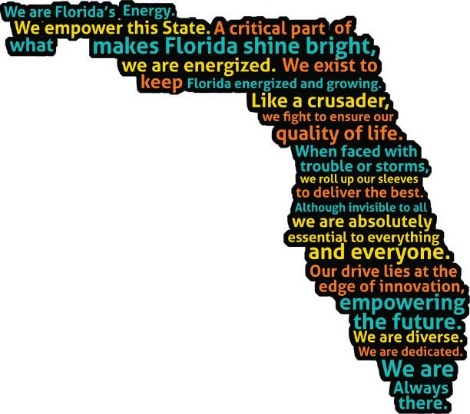




Learn more about
energy careers online
getintoenergyflorida.com

